Slide 1
Wednesday - Message Web Application
Group Presentation

Slide 2
Group Member
Members: {zhou.liha, liu.bo2, chen.jiey, tong.xi}@husky.neu.edu
001302072 Lihang Zhou
001057068 Bo Liu
001398614 Jieying Chen
001306762 Xing Tong

Slide 3
Overview
Our project is a message application.
· We provide a platform for people to create chat and communicate online with friends by sending texts and emoji.
·Users in groups can receive info simultaneously.
·App enables users to delete messages.
·Users can update their profile.

Slide 4





Part 1:
Welcome Page
Part 3:
Chat Page
Part 5:
Back-End
THANK YOU!
Part 4:
Profile
Part 2:
Login Page

Slide 5
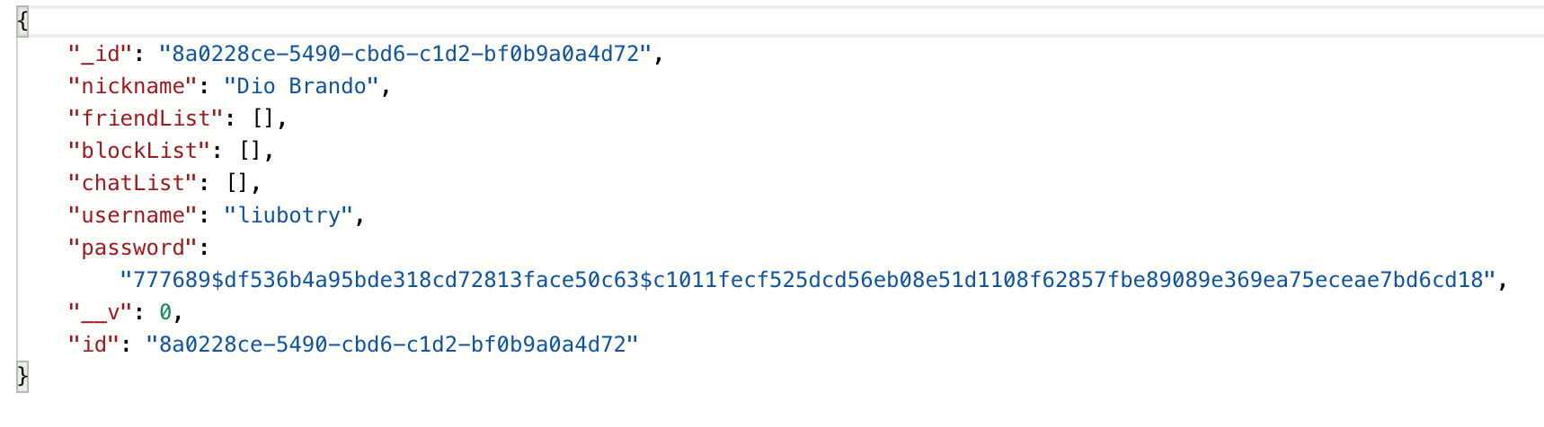
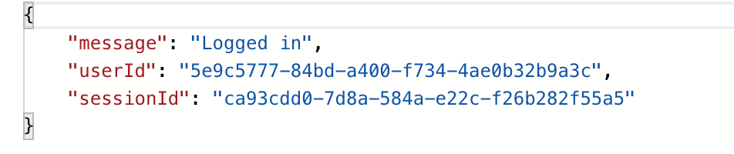
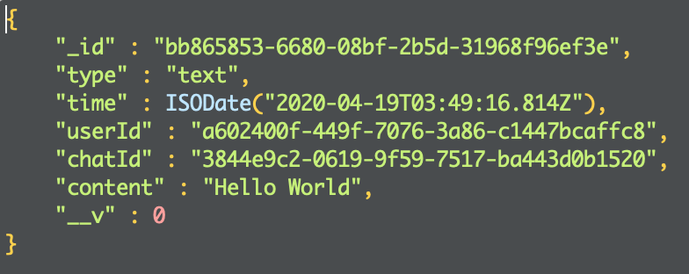
Data Structure
1.User Data Structure
· password is encrypted in the backend instead of plaintext.
2.Message Data Structure
·give new session Id while user log in every time.

Slide 6
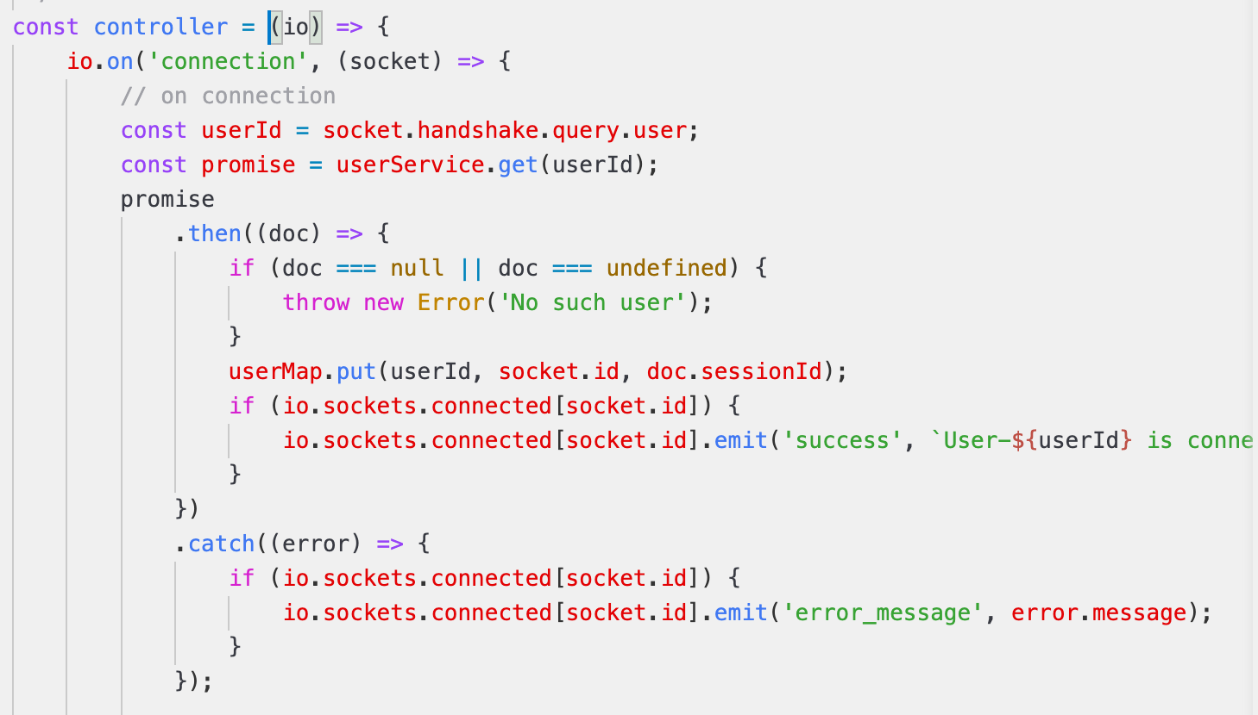
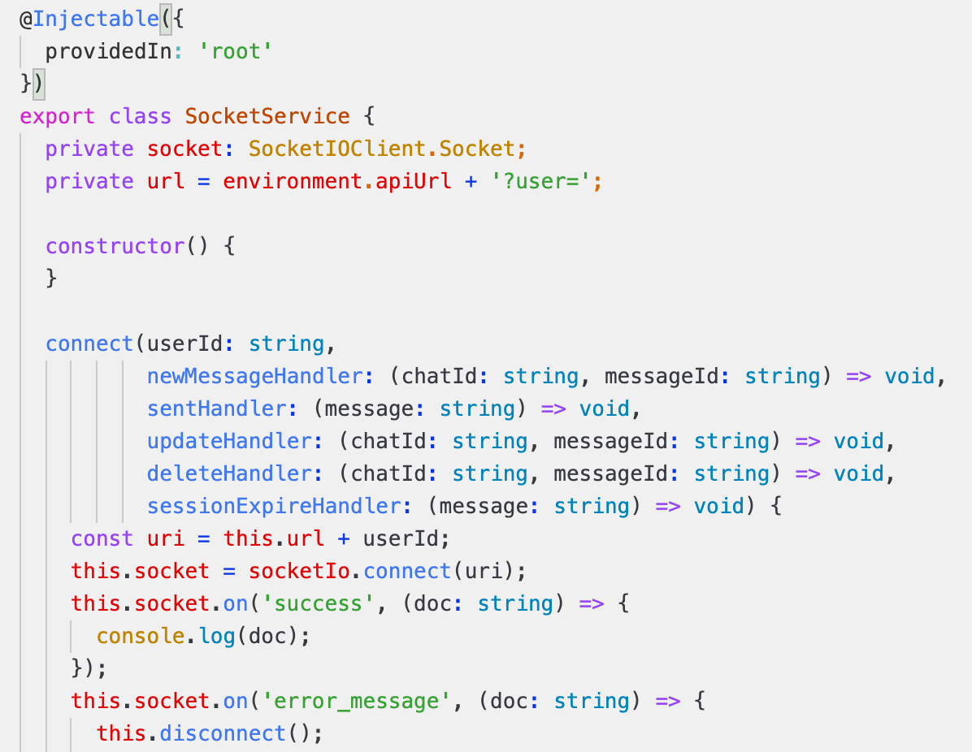
WebSocket
Server：
Client：

Slide 7
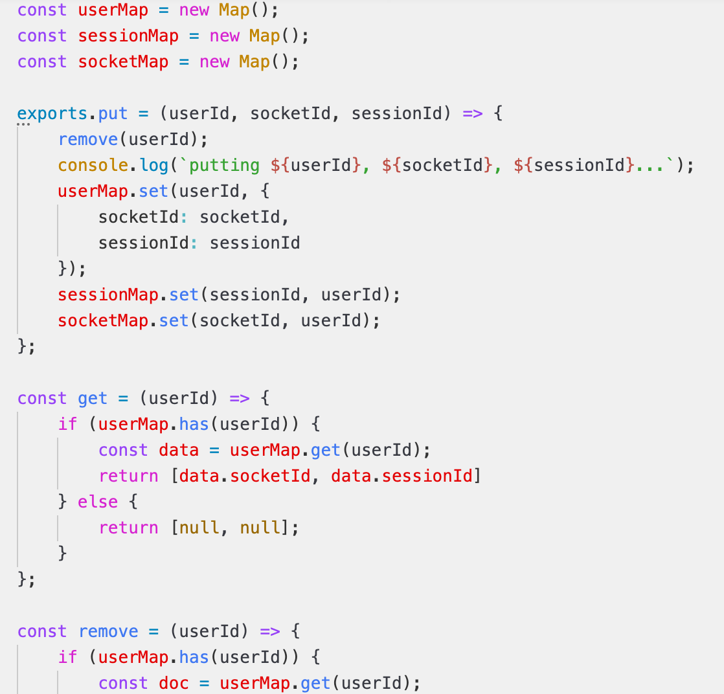
Map
Map:

Slide 8
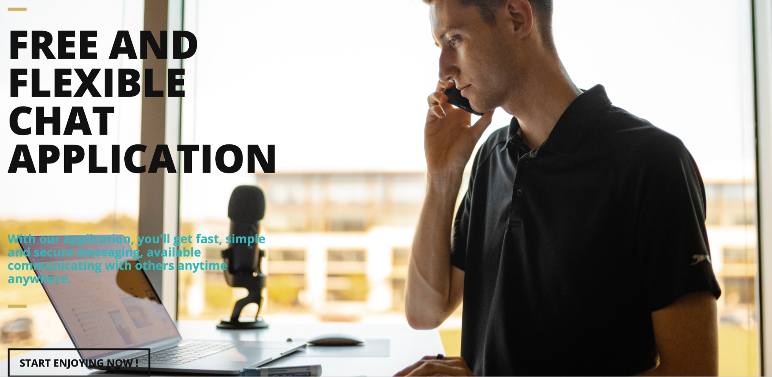
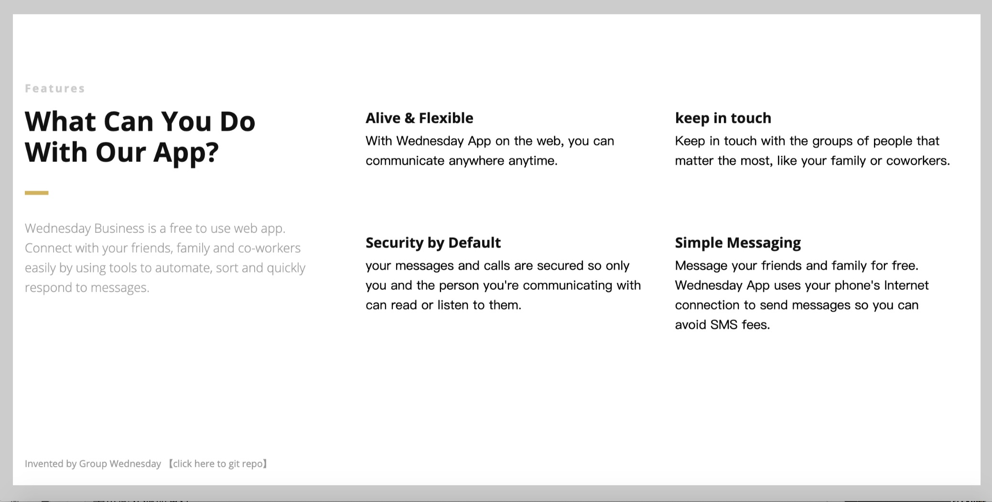
User Interface

Slide 9
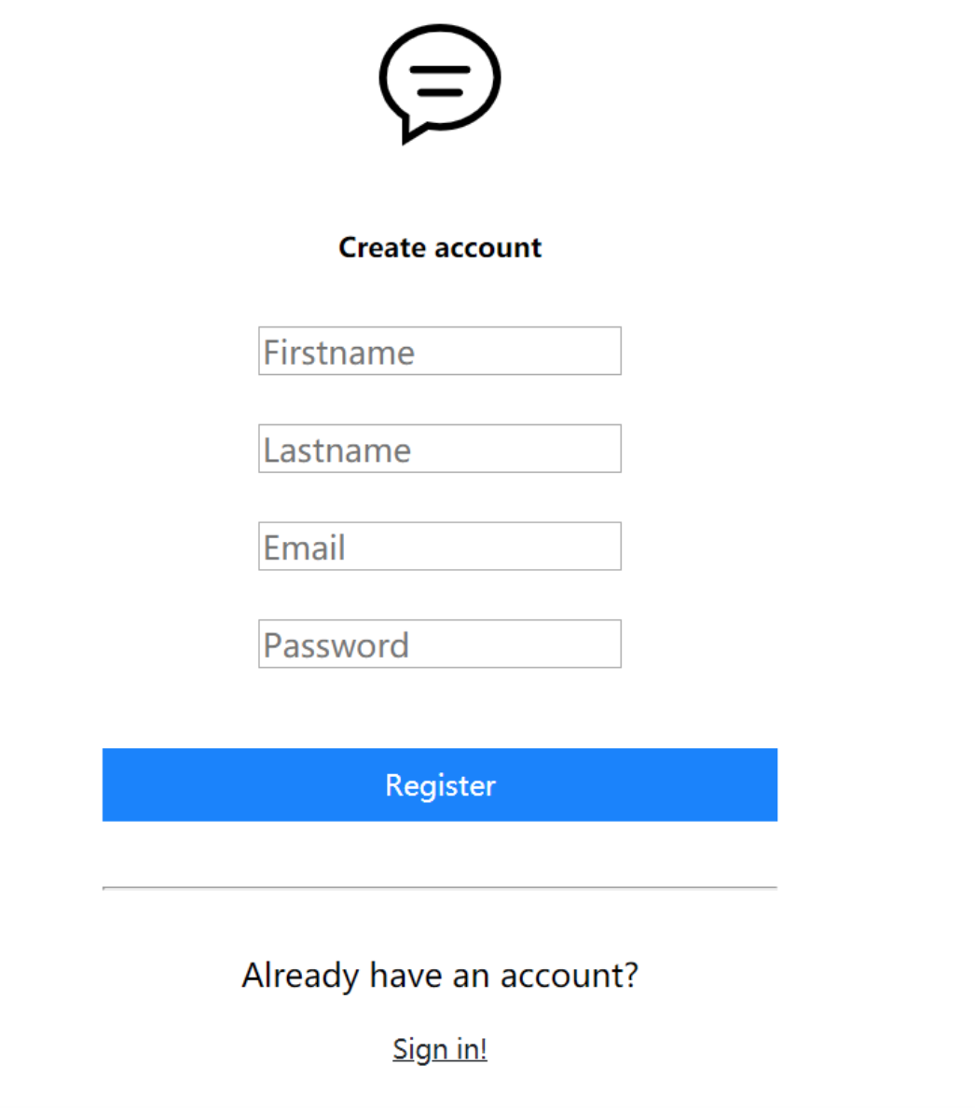
Login-page

Slide 10
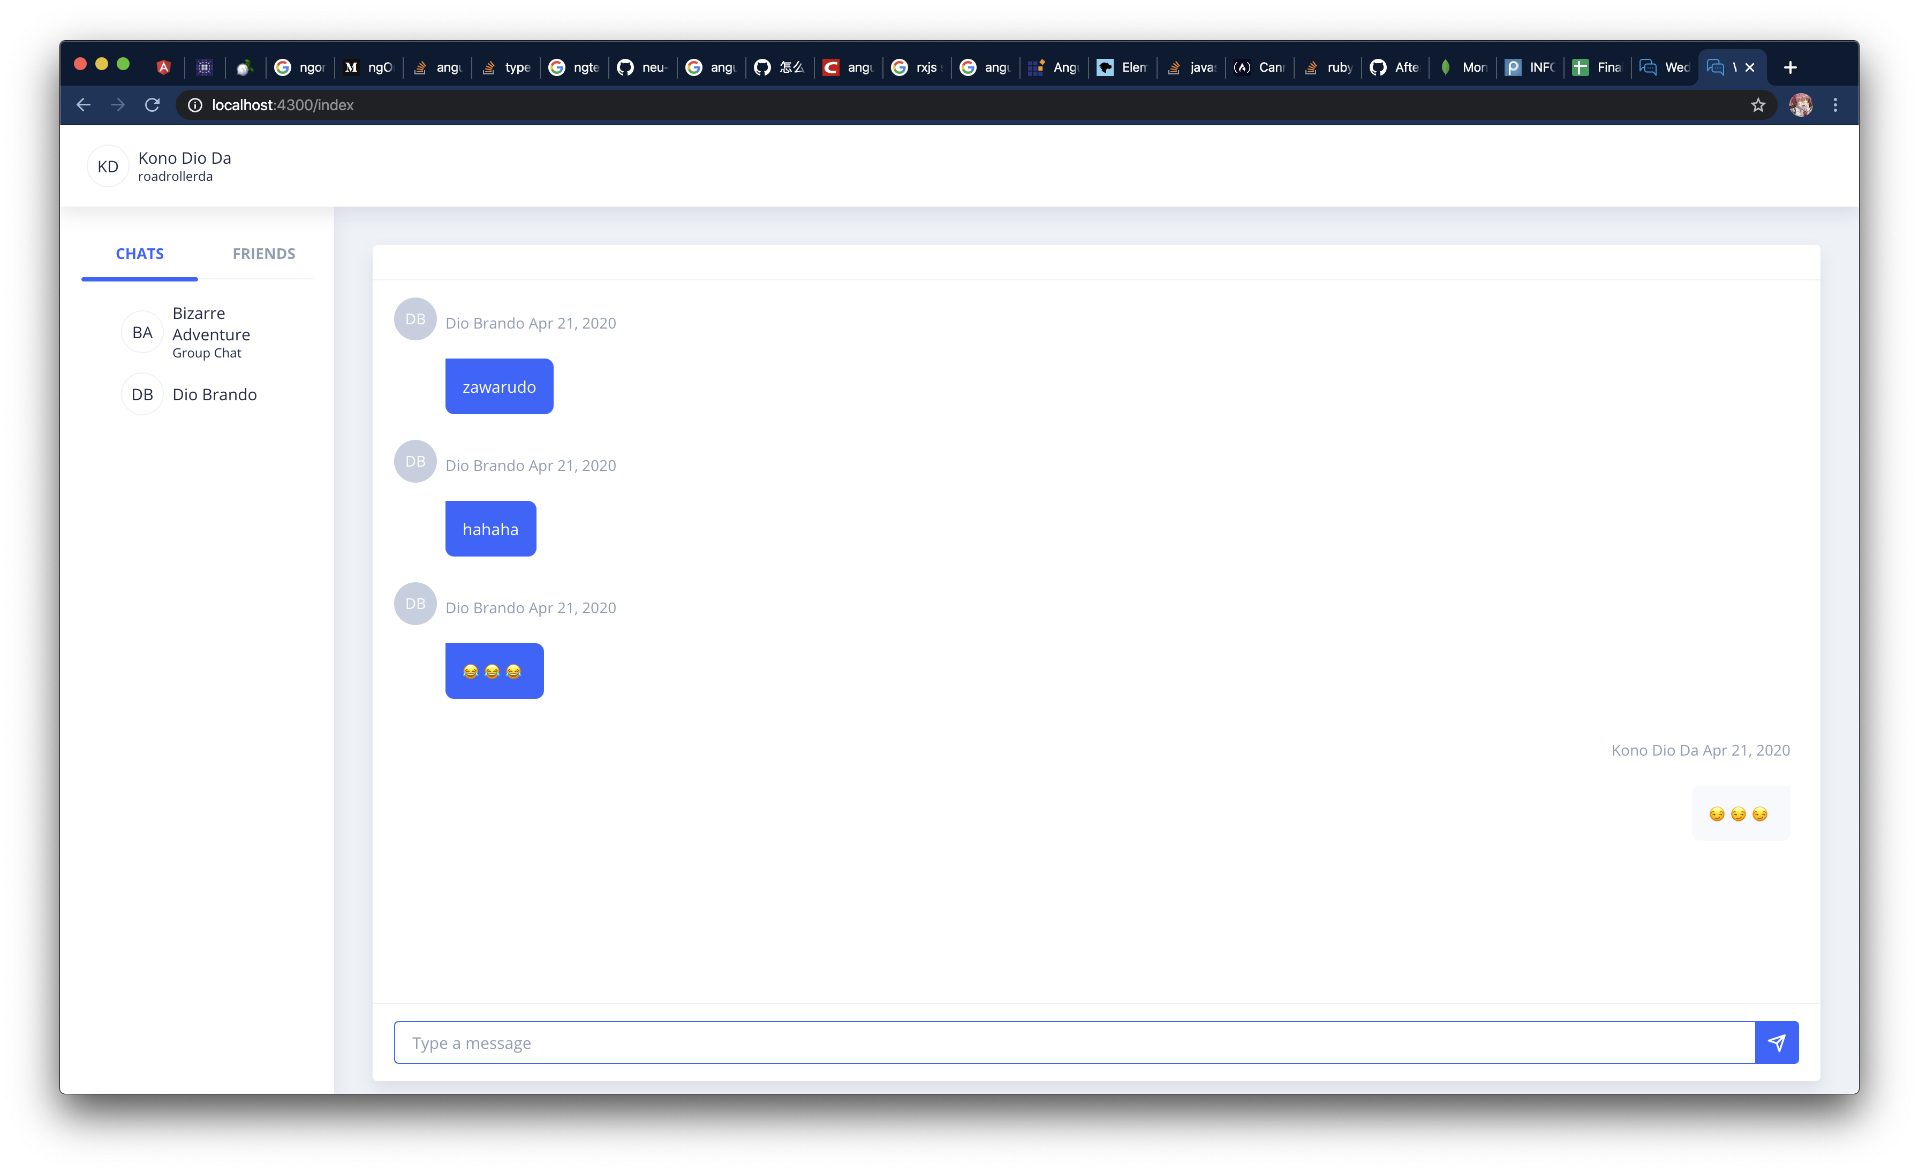
Chat-page

Slide 11
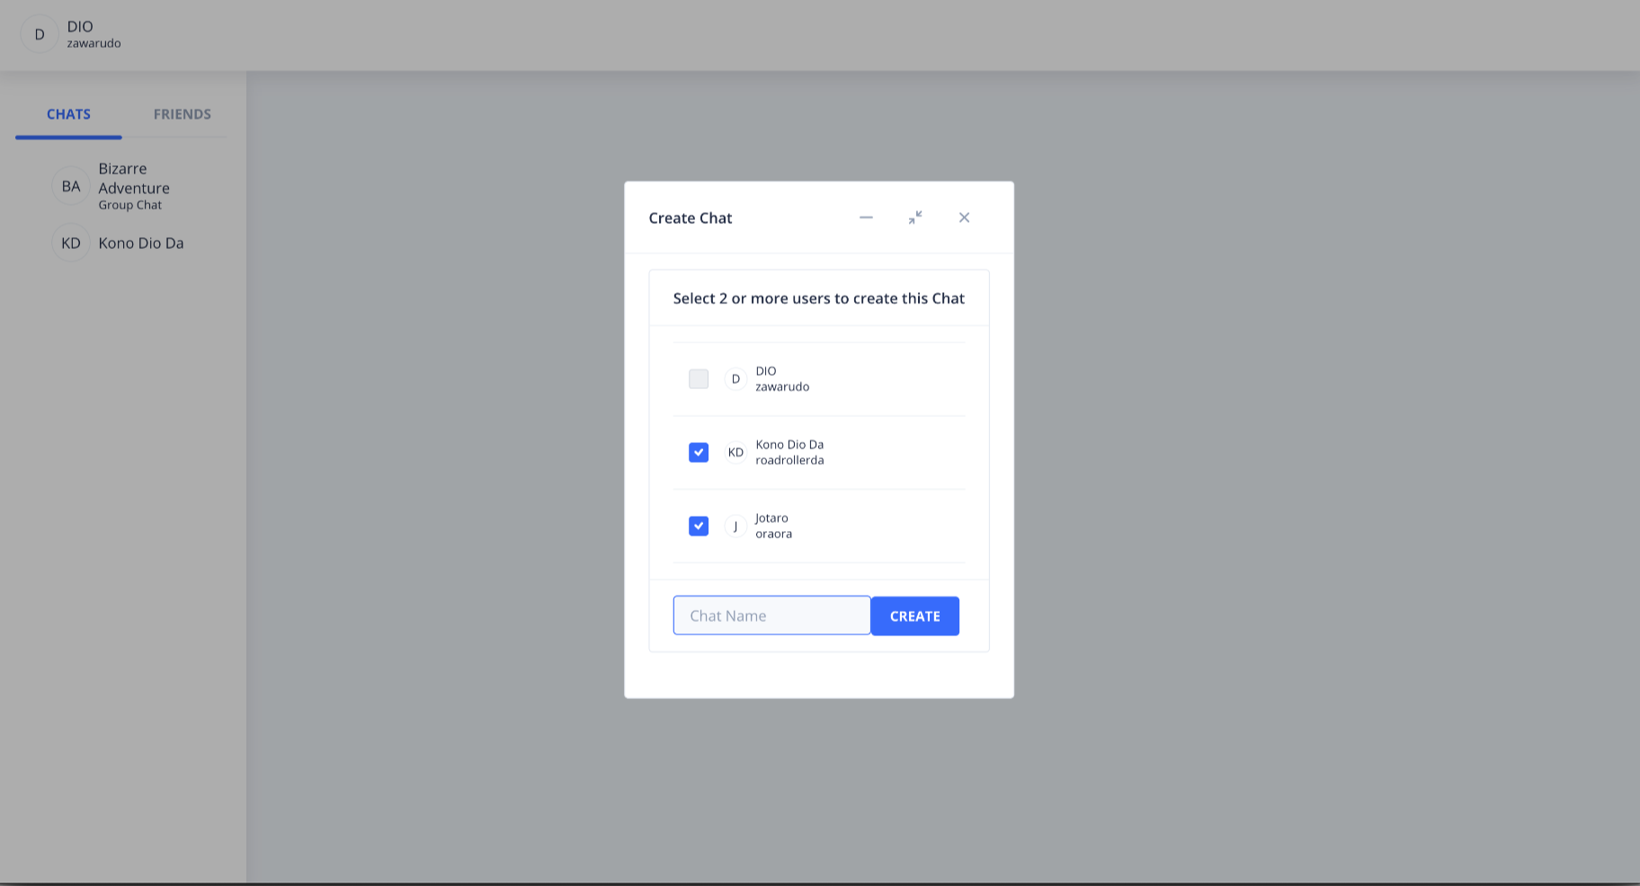
Create Chat

Slide 12
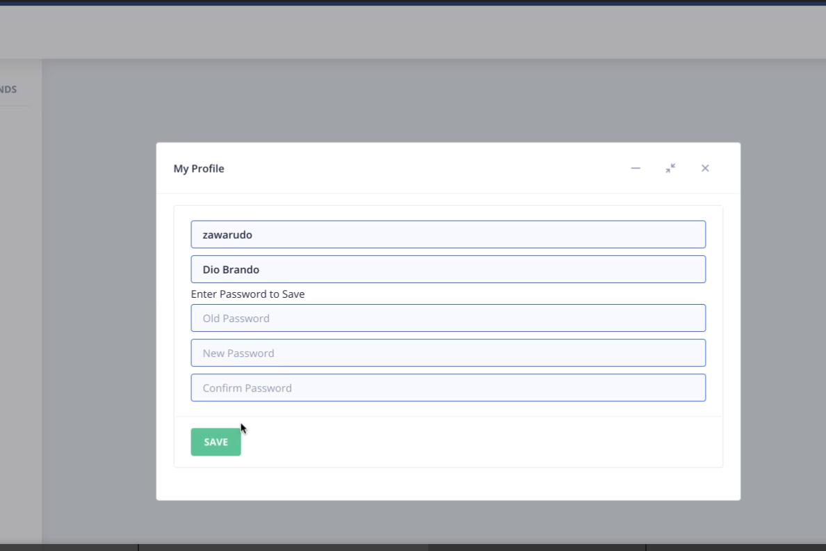
Profile Update

Slide 13
THANK YOU !

